Slide 1
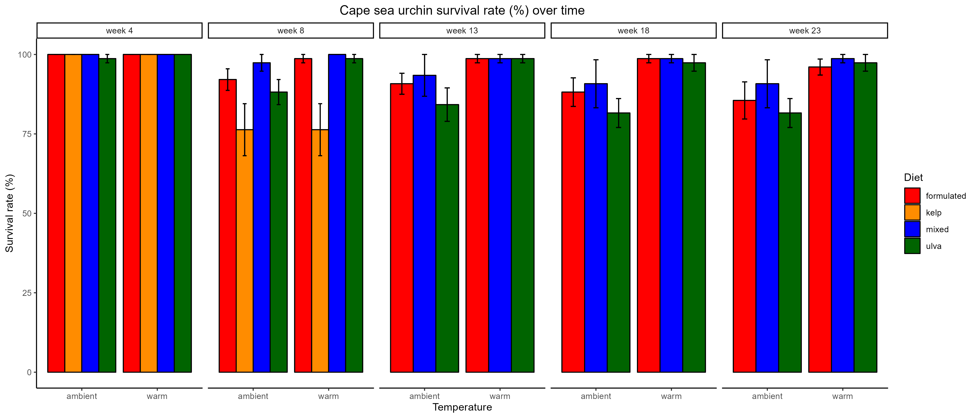
a
a
a
a
ab
ab
b
b

Slide 2
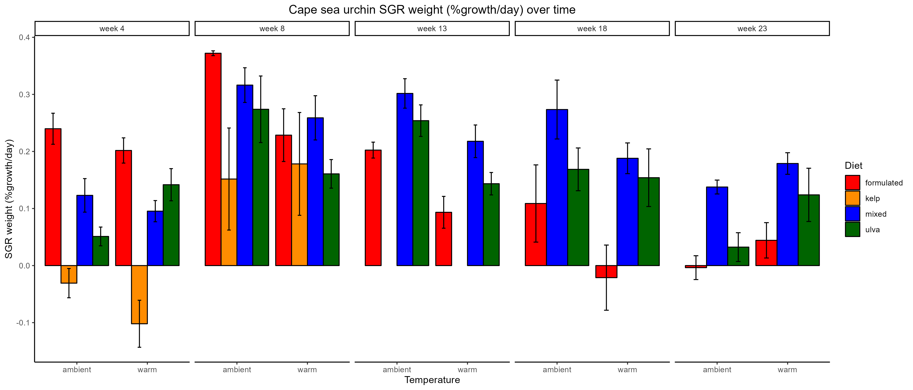
a
ab
ab
C
A
ab
C
ab
E
ab
ab
BC
DE
ABC
AB
b
AB
AB
C
CDE
AB
AB
BC
CDE
BC
BCD
A
BC
AB
AB
B
A
AB
A

Slide 3
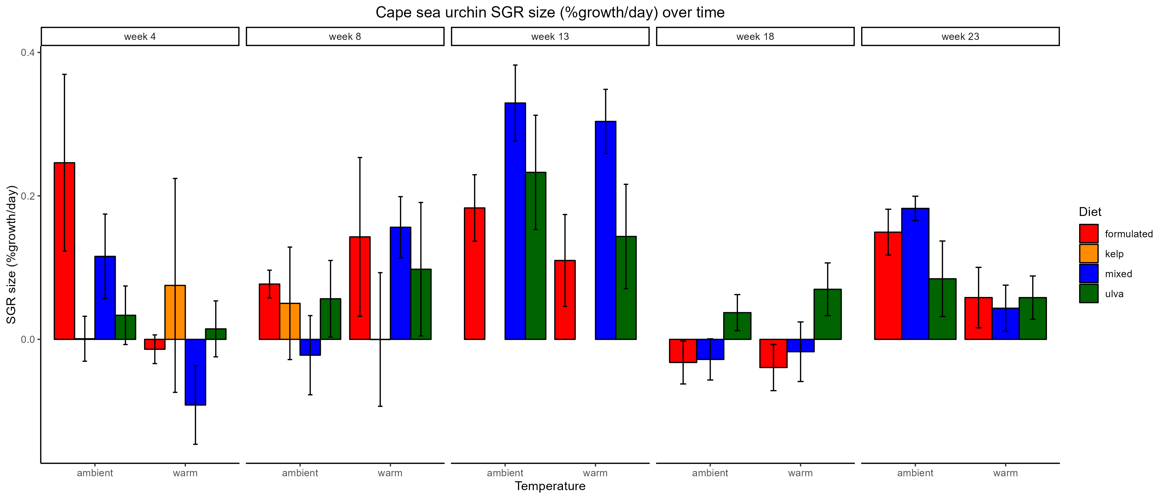

Slide 4
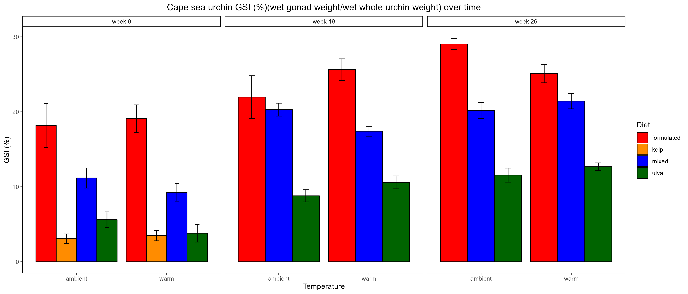
A
A
AB
A
B
a
a
A
B
AB
a
C
C
B
ac
B
abc
b
bc
b

Slide 5
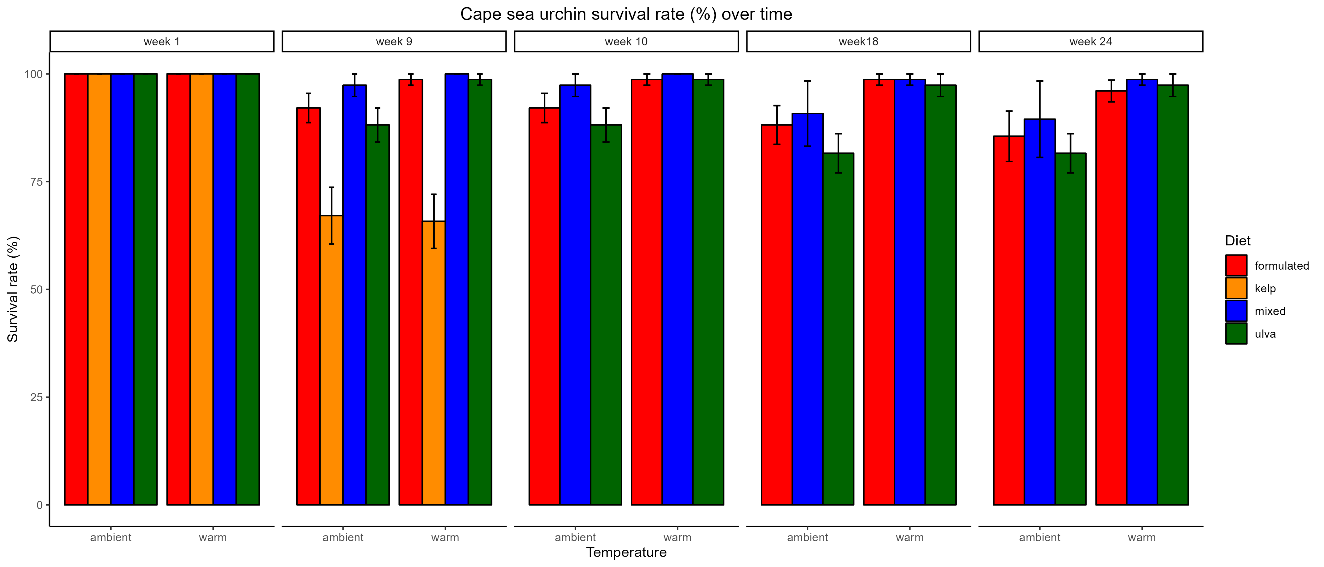
a
a
a
a
*
**
*
ab
ab
b
b

Slide 6
Doing diet & temp differences from now on
Diet as letters
Temp as stars

Slide 7
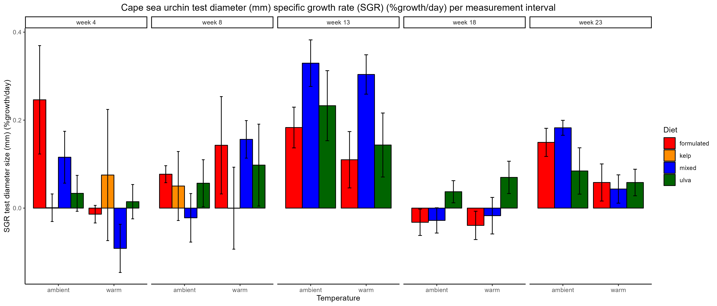
##
B
B
AB
A
AB
***
A
B
B
AB
A
AB
A

Slide 8
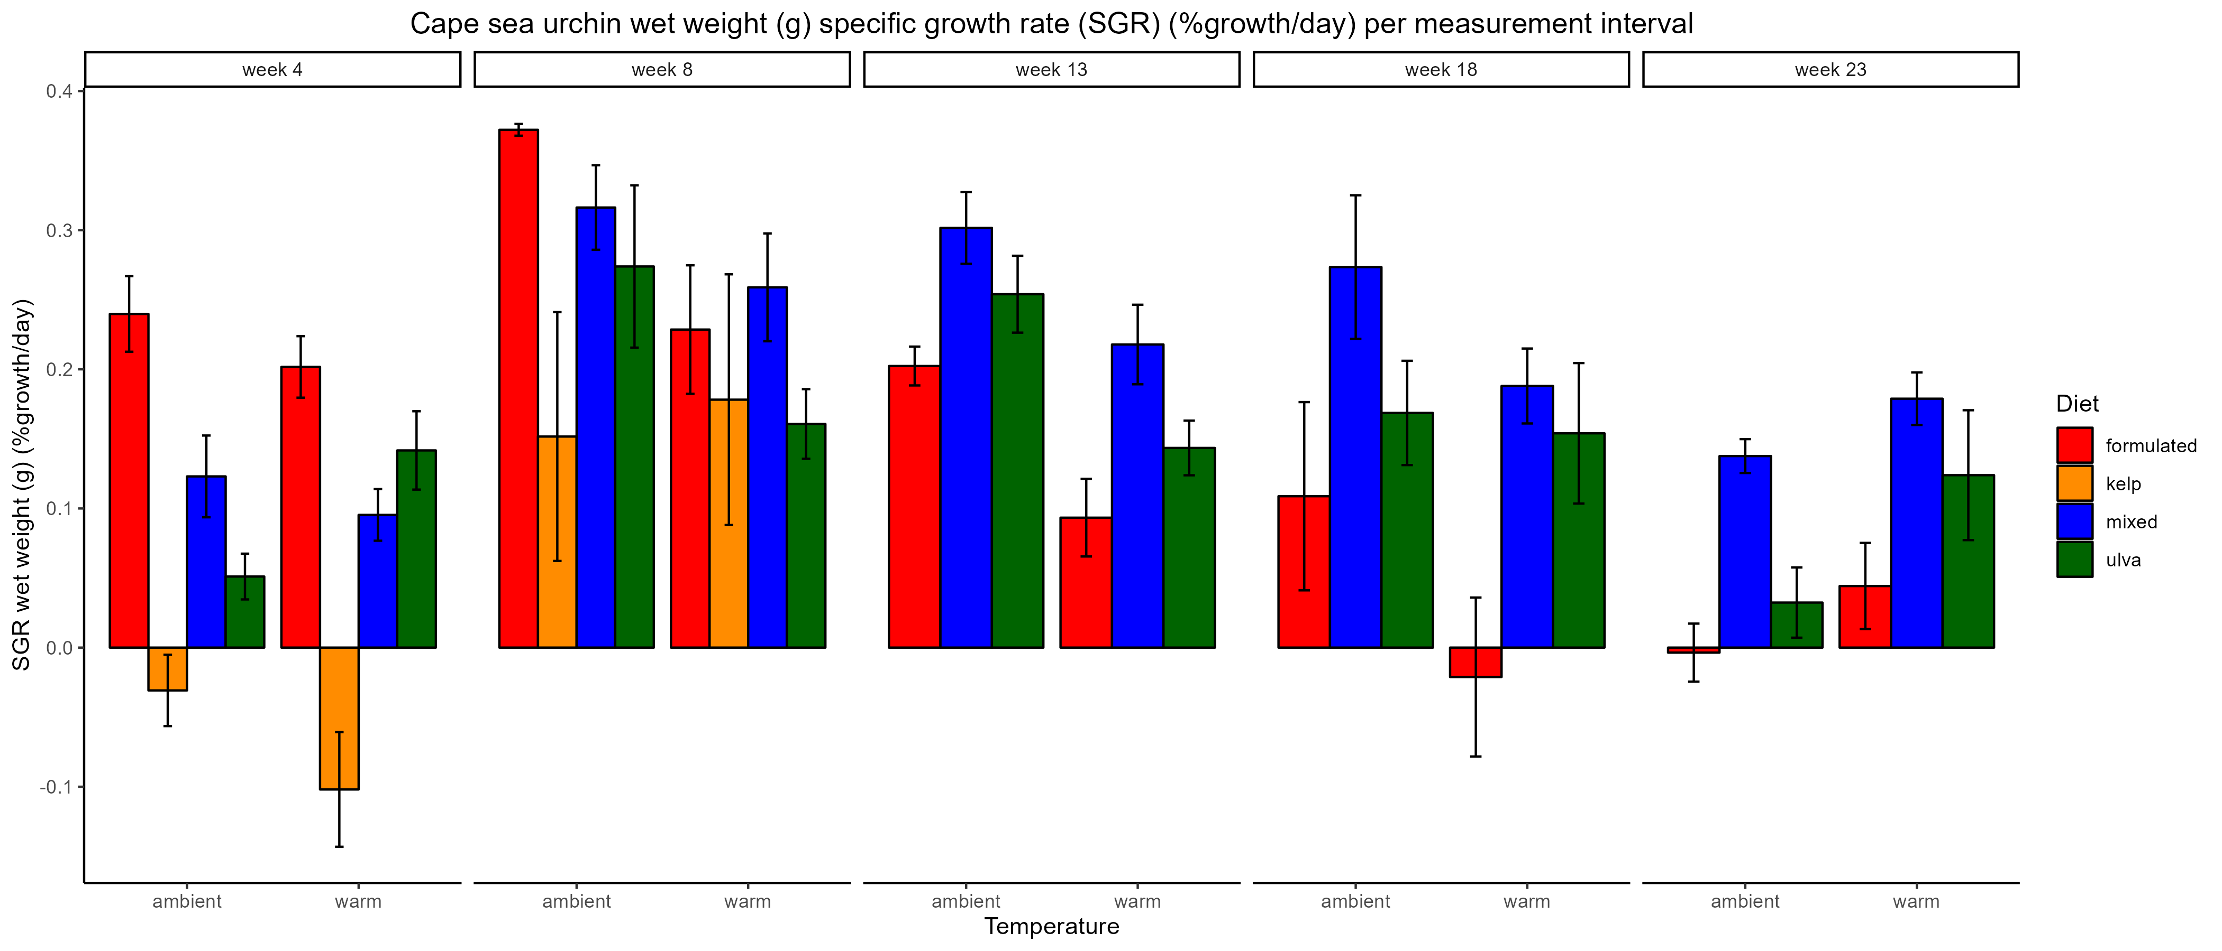
***
B
B
C
AB
B
C
A
B
AB
AB
B
A
AB
A
A
A
B
A
A
A
A
A
A
B
B
A

Slide 9
b
b
b
b
##
##
##
b
b
a
a

Slide 10
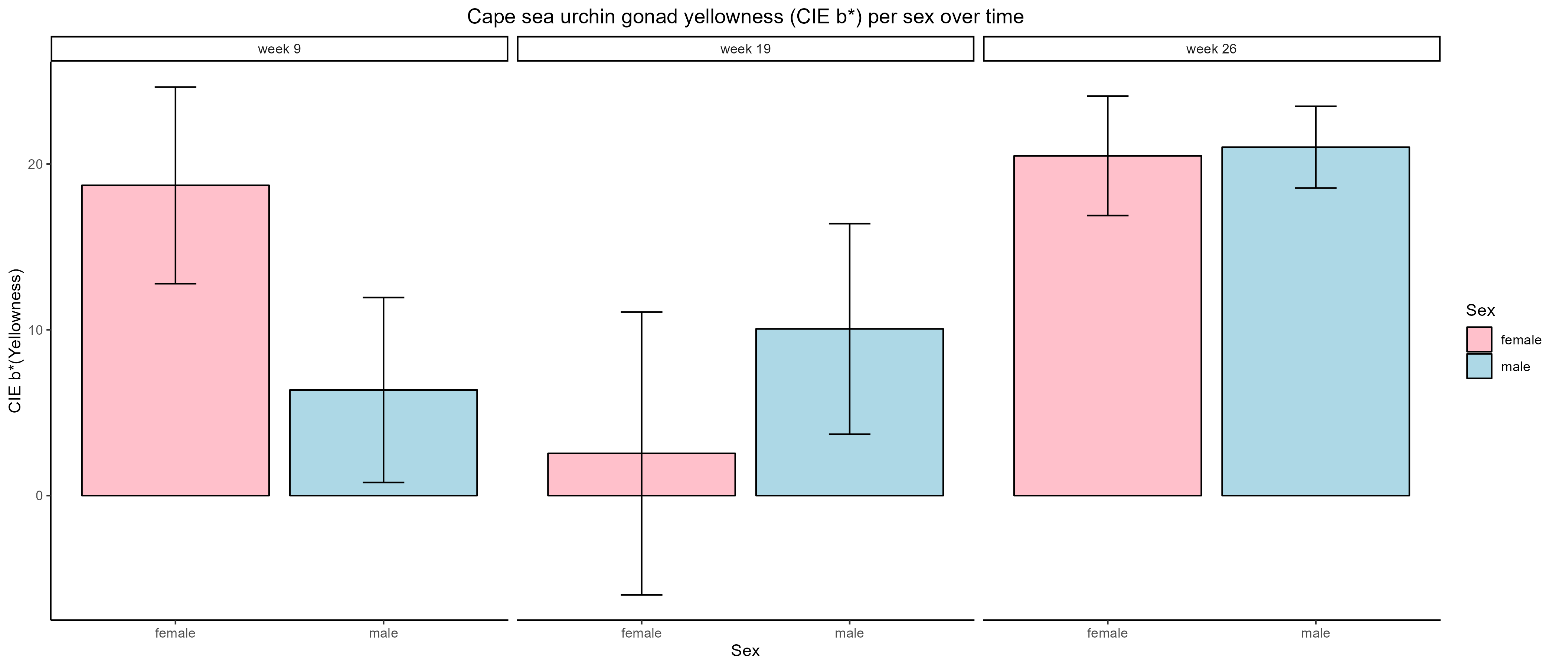

Slide 11
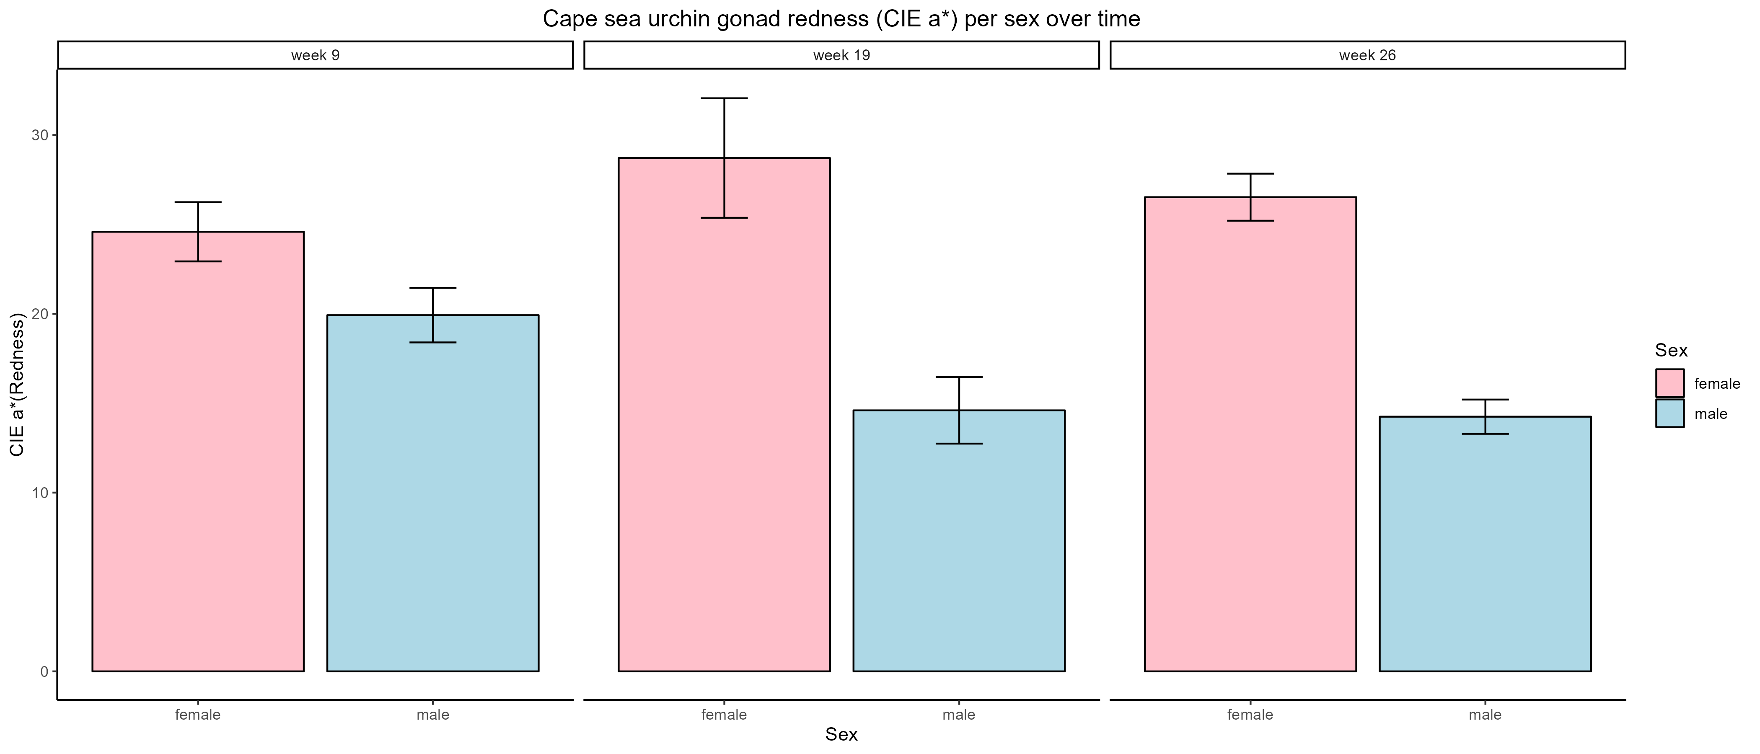
***
*
***

Slide 12
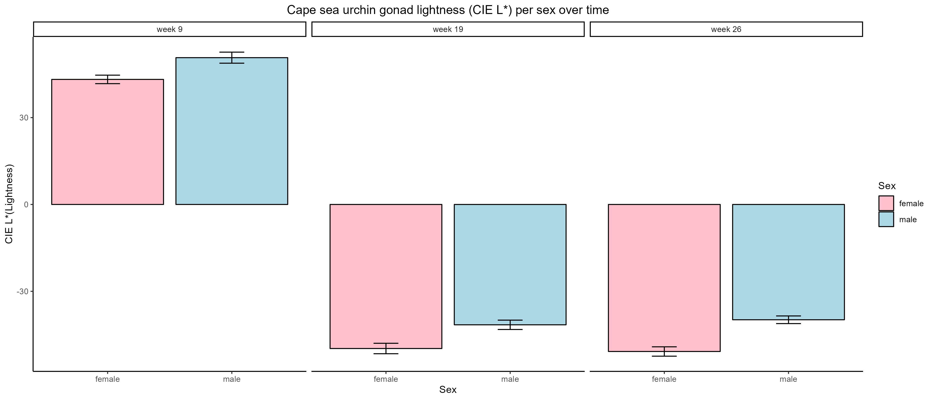
**
##
**

Slide 13
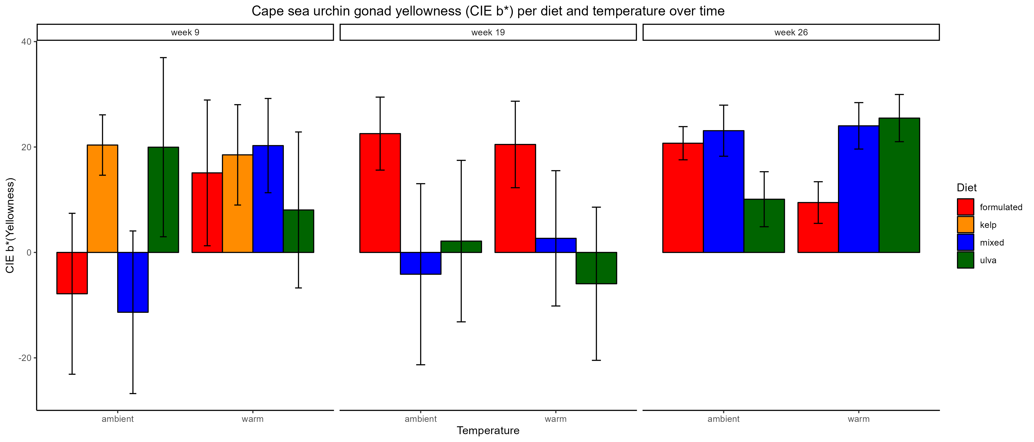
a
a
ab
b
ab
b

Slide 14
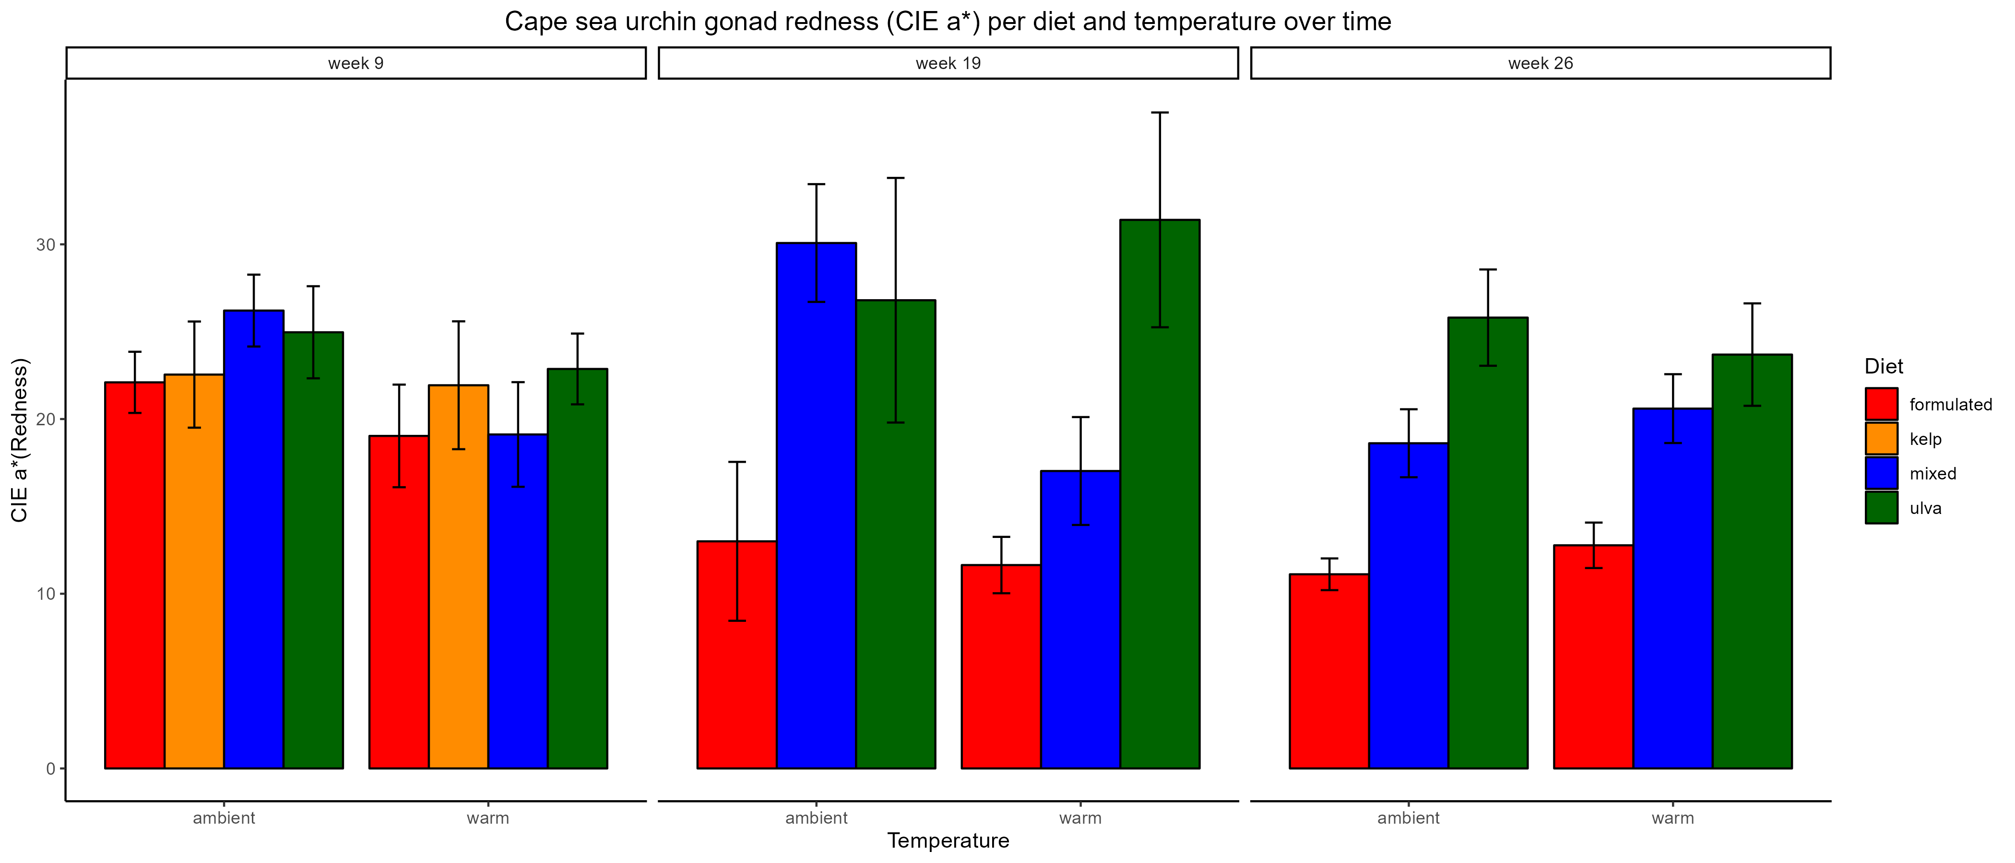
A
AB
A
B
B
B
AB
B
B
B
A
A

Slide 15
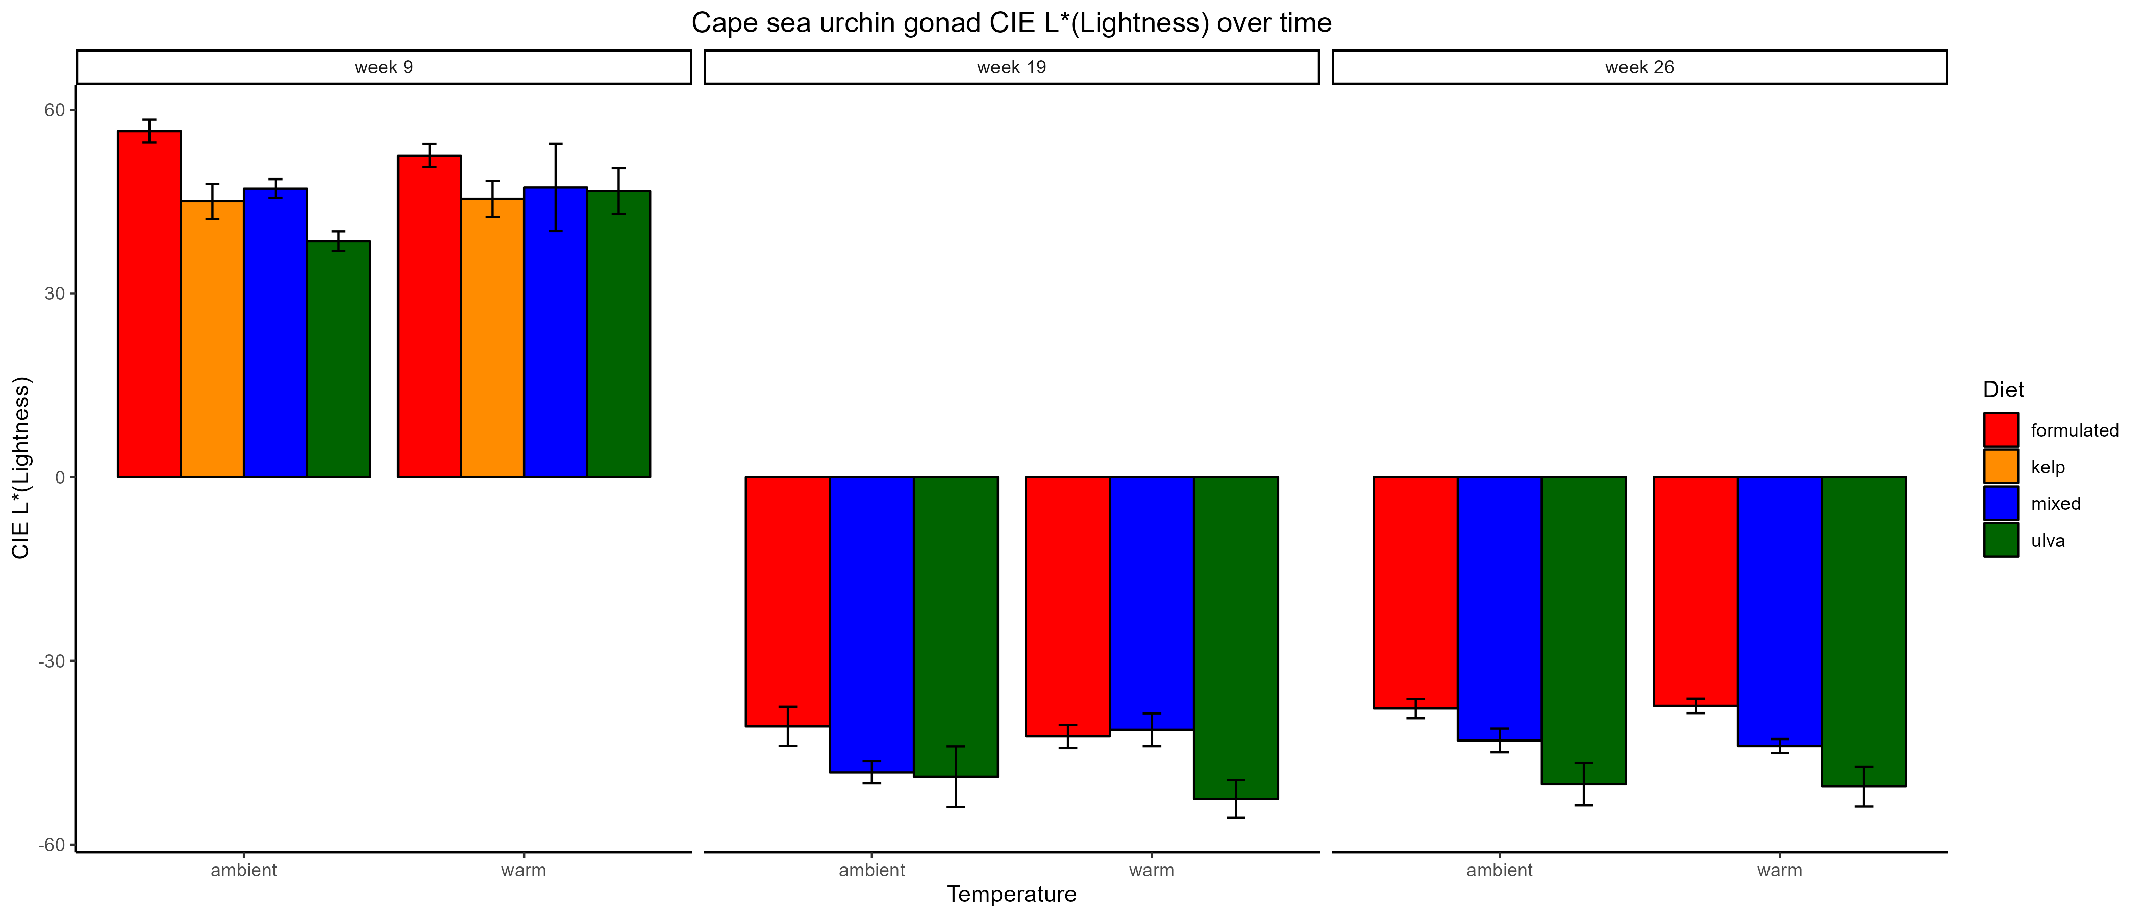
B
B
AB
A
A
AB
A
A
B
AB
A
B
AB
A
a
b
b
a
b
b

Slide 16
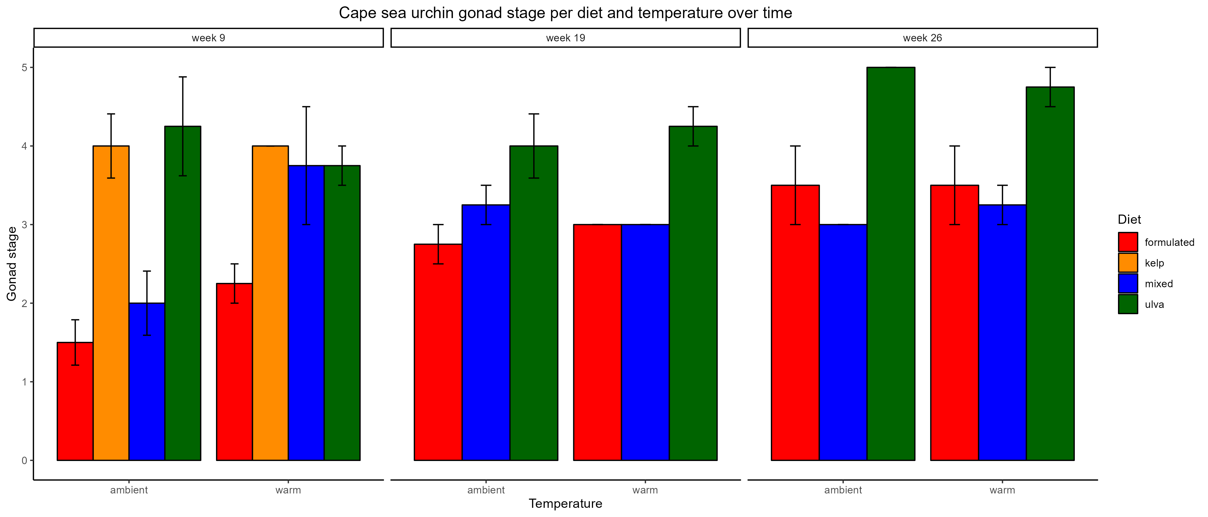
a
b
b
a
ab
b
b
a
a
a
a
a
a
a
a
a
a
ab
b
b

Slide 17

C
C
C
C
A
B
B
A
A
A
B
B
B
B
B
B
A
A
A
A

Slide 19
**
B
B
C
AB
B
C
A
AB
B
AB
B
A
AB
A
A
A
B
A
A
A
A
A
A
A
B
B

Slide 20
**
B
**
B
AB
A
AB
A
B
B
AB
A
AB
A

